Slide 1
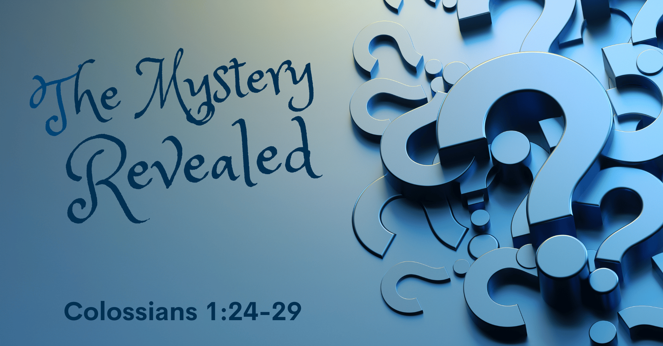
Notes:
The Mystery Revealed
Colossians 1:24-29
(Colossians 1:24-29), “I now rejoice in my sufferings for you, and fill up in my flesh what is lacking in the afflictions of Christ, for the sake of His body, which is the church, ²⁵ of which I became a minister according to the stewardship from God which was given to me for you, to fulfill the word of God, ²⁶ the mystery which has been hidden from ages and from generations, but now has been revealed to His saints. ²⁷ To them God willed to make known what are the riches of the glory of this mystery among the Gentiles: which is Christ in you, the hope of glory. ²⁸ Him we preach, warning every man and teaching every man in all wisdom, that we may present every man perfect in Christ Jesus. ²⁹ To this end I also labor, striving according to His working which works in me mightily.”
Definition: Mystery – Almost universally translated Mystery (or secret) mystērion, moos-tay'-ree-on - a hidden or secret thing, not obvious to the understanding
Definition: Hidden – has been hidden (apokryptō, ap-ok-roop’-to) – concealed, kept secret
Definition: Make known - (gnōrizō, gno-rid’-zo) – to be brought to knowledge
(1 Corinthians 2:11), “For what man knows the things of a man except the spirit of the man which is in him? Even so no one knows the things of God except the Spirit of God.”
The importance of the Mystery
The suffering of Paul for the church, the body of Christ
The concept of Stewardship, from God to man
The Mystery Itself
Hidden from ages and generations
The Mystery Revealed
To the Saints
By the Saints to the Gentiles
D. What is the Mystery?
Christ in you, the hope of glory
Creating every man perfect in Christ Jesus
Salvation in the New Covenants

Slide 2
The Importance of the Mystery
Philippians 3:-11
2 Corinthians 11:22-28
1 Corinthians 4:1-5
Notes:
The importance of the Mystery
The importance of the mystery is seen in what Paul gave up in his ministry
(Philippians 3:8-11), “Yet indeed I also count all things loss for the excellence of the knowledge of Christ Jesus my Lord, for whom I have suffered the loss of all things, and count them as rubbish, that I may gain Christ ⁹ and be found in Him, not having my own righteousness, which is from the law, but that which is through faith in Christ, the righteousness which is from God by faith; ¹⁰ that I may know Him and the power of His resurrection, and the fellowship of His sufferings, being conformed to His death, ¹¹ if, by any means, I may attain to the resurrection from the dead.”
The suffering of Paul for the church, the body of Christ
(2 Corinthians 11:22-28), “Are they Hebrews? So am I. Are they Israelites? So am I. Are they the seed of Abraham? So am I. ²³ Are they ministers of Christ?—I speak as a fool—I am more: in labors more abundant, in stripes above measure, in prisons more frequently, in deaths often. ²⁴ From the Jews five times I received forty stripes minus one. ²⁵ Three times I was beaten with rods; once I was stoned; three times I was shipwrecked; a night and a day I have been in the deep; ²⁶ in journeys often, in perils of waters, in perils of robbers, in perils of my own countrymen, in perils of the Gentiles, in perils in the city, in perils in the wilderness, in perils in the sea, in perils among false brethren; ²⁷ in weariness and toil, in sleeplessness often, in hunger and thirst, in fastings often, in cold and nakedness— ²⁸ besides the other things, what comes upon me daily: my deep concern for all the churches.”
The concept of Stewardship (given to Paul and the other apostles) , from God to man
(1 Corinthians 4:1-5), “Let a man so consider us, as servants of Christ and stewards of the mysteries of God. ² Moreover it is required in stewards that one be found faithful. ³ But with me it is a very small thing that I should be judged by you or by a human court. In fact, I do not even judge myself. ⁴ For I know of nothing against myself, yet I am not justified by this; but He who judges me is the Lord. ⁵ Therefore judge nothing before the time, until the Lord comes, who will both bring to light the hidden things of darkness and reveal the counsels of the hearts. Then each one's praise will come from God.”

Slide 3
The Mystery Itself
Hebrews 11:39-40
2 Corinthians 3:12-16
Acts 17:30-31
Notes:
The Mystery Itself (again, that which is not known in ages and generations past
(Hebrews 11:39-40), “And all these, having obtained a good testimony through faith, did not receive the promise, ⁴⁰ God having provided something better for us, that they should not be made perfect apart from us.”
(2 Corinthians 3:12-16), “Therefore, since we have such hope, we use great boldness of speech— ¹³ unlike Moses, who put a veil over his face so that the children of Israel could not look steadily at the end of what was passing away. ¹⁴ But their minds were blinded. For until this day the same veil remains unlifted in the reading of the Old Testament, because the veil is taken away in Christ. ¹⁵ But even to this day, when Moses is read, a veil lies on their heart. ¹⁶ Nevertheless when one turns to the Lord, the veil is taken away.”
(Acts 17:30-31), “Truly, these times of ignorance God overlooked, but now commands all men everywhere to repent, ³¹ because He has appointed a day on which He will judge the world in righteousness by the Man whom He has ordained. He has given assurance of this to all by raising Him from the dead.”

Slide 4
The Mystery Revealed
Acts 2:14-24
Isaiah 1:1-2
Acts 10:34-35; Gal. 3:28-29
Notes:
The Mystery Revealed
To the Saints (First preached to the Jews on Pentecost)
(Acts 2:14-24), “But Peter, standing up with the eleven, raised his voice and said to them, “Men of Judea and all who dwell in Jerusalem, let this be known to you, and heed my words. ¹⁵ For these are not drunk, as you suppose, since it is only the third hour of the day. ¹⁶ But this is what was spoken by the prophet Joel: ¹⁷ ‘And it shall come to pass in the last days, says God, That I will pour out of My Spirit on all flesh; Your sons and your daughters shall prophesy, Your young men shall see visions, Your old men shall dream dreams. ¹⁸ And on My menservants and on My maidservants I will pour out My Spirit in those days; And they shall prophesy. ¹⁹ I will show wonders in heaven above And signs in the earth beneath: Blood and fire and vapor of smoke. ²⁰ The sun shall be turned into darkness, And the moon into blood, Before the coming of the great and awesome day of the Lord. ²¹ And it shall come to pass That whoever calls on the name of the Lord Shall be saved.’ ²² “Men of Israel, hear these words: Jesus of Nazareth, a Man attested by God to you by miracles, wonders, and signs which God did through Him in your midst, as you yourselves also know— ²³ Him, being delivered by the determined purpose and foreknowledge of God, you have taken by lawless hands, have crucified, and put to death; ²⁴ whom God raised up, having loosed the pains of death, because it was not possible that He should be held by it.
By the Saints to the Gentiles
(Isaiah 1:1-2), “The word that Isaiah the son of Amoz saw concerning Judah and Jerusalem. ² Now it shall come to pass in the latter days That the mountain of the Lord's house Shall be established on the top of the mountains, And shall be exalted above the hills; And all nations shall flow to it.”
(Acts 10:34-35), “Then Peter opened his mouth and said: “In truth I perceive that God shows no partiality. ³⁵ But in every nation whoever fears Him and works righteousness is accepted by Him.”
(Galatians 3:28-29), “There is neither Jew nor Greek, there is neither slave nor free, there is neither male nor female; for you are all one in Christ Jesus. ²⁹ And if you are Christ's, then you are Abraham's seed, and heirs according to the promise.”
D. What is the Mystery?
Christ in you, the hope of glory
Creating every man perfect in Christ Jesus
Salvation in the New Covenants

Slide 5
What is the Mystery?
Ephesians 1:3-4
Ephesians 5:25-27
Matthew 26:27-29
Notes:
What is the Mystery?
Christ in you, the hope of glory
(Ephesians 1:3-4), “Blessed be the God and Father of our Lord Jesus Christ, who has blessed us with every spiritual blessing in the heavenly places in Christ, ⁴ just as He chose us in Him before the foundation of the world, that we should be holy and without blame before Him in love.”
Creating every man perfect in Christ Jesus
(Ephesians 5:25-27), “Husbands, love your wives, just as Christ also loved the church and gave Himself for her, ²⁶ that He might sanctify and cleanse her with the washing of water by the word, ²⁷ that He might present her to Himself a glorious church, not having spot or wrinkle or any such thing, but that she should be holy and without blemish.”
Salvation in the New Covenant
(Matthew 26:27-29), “Then He took the cup, and gave thanks, and gave it to them, saying, “Drink from it, all of you. ²⁸ For this is My blood of the new covenant, which is shed for many for the remission of sins. ²⁹ But I say to you, I will not drink of this fruit of the vine from now on until that day when I drink it new with you in My Father's kingdom.”

