Slide 1
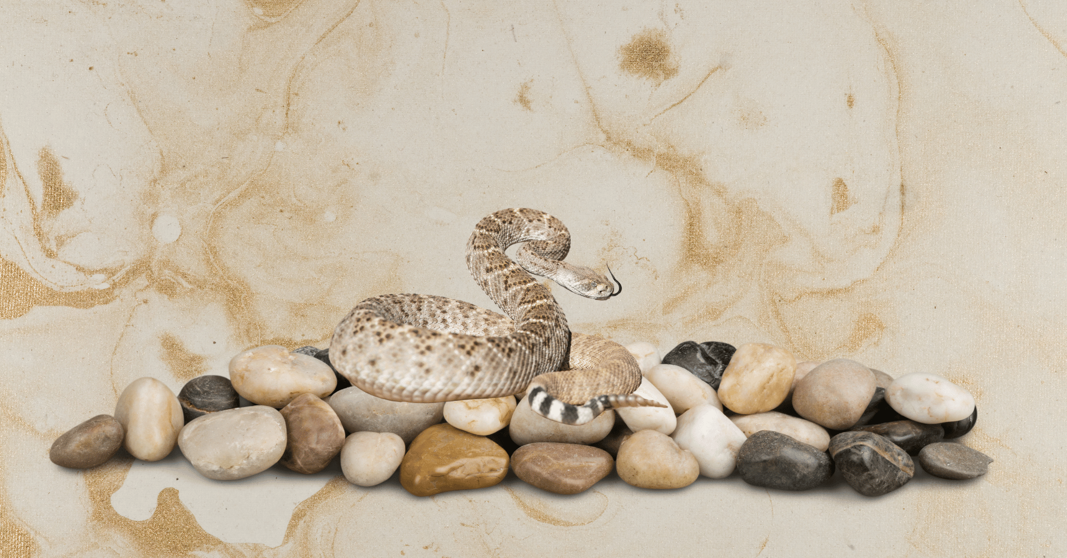
Stones and Serpents
Matthew 7:7-12
Notes:
STONES AND SERPENTS
(Matthew 7:7-12), “Ask, and it will be given to you; seek, and you will find; knock, and it will be opened to you. ⁸ For everyone who asks receives, and he who seeks finds, and to him who knocks it will be opened. ⁹ Or what man is there among you who, if his son asks for bread, will give him a stone? ¹⁰ Or if he asks for a fish, will he give him a serpent? ¹¹ If you then, being evil, know how to give good gifts to your children, how much more will your Father who is in heaven give good things to those who ask Him! ¹² Therefore, whatever you want men to do to you, do also to them, for this is the Law and the Prophets.”
The Primary point Jesus makes here is that God blesses us through answered prayer.
As our Heavenly Father, He loves us, knows what is best for us, and is willing to give us what we need (bread and fish, rather than what we want).
But, notice the contrast given here between God and men (They are evil, whereas God is good).
Even as men, (being evil), we still desire to do what is best for our children
Also give bread and fish rather than stones and serpents
However, not all are good at it. In fact, some don’t even try
Abusers and those who do not show proper care for children. (Deadbeat dads, those who have their children taken away by social services).
Unfortunately, Parenting does not come with a manual. However, there are wonderful concepts from God’s word we can refer to for guidance.
Consider a few examples.
Joe R. Price Sep 10, 2000

Slide 2
We give our children stones and serpents when…
They Ask For (Need) Our Time & Affection & Instead We Give Them Material Things
1 Samuel 1:20-23; 2:18-21
Notes:
WE GIVE OUR CHILDREN STONES & SERPENTS....
When They Ask For (Need) Our Time & Affection & Instead We Give Them Material
(1 Samuel 1:20-23), “So it came to pass in the process of time that Hannah conceived and bore a son, and called his name Samuel, saying, “Because I have asked for him from the LORD.” ²¹ Now the man Elkanah and all his house went up to offer to the LORD the yearly sacrifice and his vow. ²² But Hannah did not go up, for she said to her husband, “Not until the child is weaned; then I will take him, that he may appear before the LORD and remain there forever.” ²³ So Elkanah her husband said to her, “Do what seems best to you; wait until you have weaned him. Only let the LORD establish His word.” Then the woman stayed and nursed her son until she had weaned him.”
(1 Samuel 2:18-21), “But Samuel ministered before the LORD, even as a child, wearing a linen ephod. ¹⁹ Moreover his mother used to make him a little robe, and bring it to him year by year when she came up with her husband to offer the yearly sacrifice. ²⁰ And Eli would bless Elkanah and his wife, and say, “The LORD give you descendants from this woman for the loan that was given to the LORD.” Then they would go to their own home. ²¹ And the LORD visited Hannah, so that she conceived and bore three sons and two daughters. Meanwhile the child Samuel grew before the LORD.”
Hanna was so thankful for her son. She was always there for him. Even after giving him away to serve the Lord, she was still there for him, bringing him the little robe year by year.
Our children need us, not the things we can give them.

Slide 3
We give our children stones and serpents when…
When They Ask For (Need) Our Guidance & Discipline & Instead We Leave Them Alone & Look The Other Way
Proverbs 4:3-4; Deut. 11:18-21; Proverbs 29:15
Notes:
WE GIVE OUR CHILDREN STONES & SERPENTS....
When They Ask For (Need) Our Guidance & Discipline & Instead We Leave Them Alone & Look The Other Way
(Proverbs 4:3-4), [Father’s direction] “When I was my father’s son, Tender and the only one in the sight of my mother, ⁴ He also taught me, and said to me: “Let your heart retain my words; Keep my commands, and live.”
(Deuteronomy 11:18-21), [Moses’ Directions to Israel], “Therefore you shall lay up these words of mine in your heart and in your soul, and bind them as a sign on your hand, and they shall be as frontlets between your eyes. ¹⁹ You shall teach them to your children, speaking of them when you sit in your house, when you walk by the way, when you lie down, and when you rise up. ²⁰ And you shall write them on the doorposts of your house and on your gates, ²¹ that your days and the days of your children may be multiplied in the land of which the LORD swore to your fathers to give them, like the days of the heavens above the earth.”
(Proverbs 29:15), [Old Fashioned, and rejected by society, but nevertheless true!] “The rod and rebuke give wisdom, But a child left to himself brings shame to his mother.”
Children need parents who have the strength to exercise consistent & reasonable discipline, regardless of the cost.
Eli did not do that with his own sons, Hophni and Phinehas. (While Samuel served diligently).
(1 Samuel 3:13), [God to Samuel], “For I have told him that I will judge his house forever for the iniquity which he knows, because his sons made themselves vile, and he did not restrain them.”

Slide 4
We give our children stones and serpents when…
When They Ask For (Need) Our Guidance On Morality & Instead We Give Them Un-restricted Access To Immoral Entertainment Ephesians 5:3-7
Notes:
WE GIVE OUR CHILDREN STONES & SERPENTS....
When They Ask For (Need) Our Guidance On Morality & Ethics & Instead We Give Them Unrestricted Access To Immoral Entertainment.
(Ephesians 5:3-7), “But fornication and all uncleanness or covetousness, let it not even be named among you, as is fitting for saints; ⁴ neither filthiness, nor foolish talking, nor coarse jesting, which are not fitting, but rather giving of thanks. ⁵ For this you know, that no fornicator, unclean person, nor covetous man, who is an idolater, has any inheritance in the kingdom of Christ and God. ⁶ Let no one deceive you with empty words, for because of these things the wrath of God comes upon the sons of disobedience. ⁷ Therefore do not be partakers with them.”
Children need strong, disciplined, spiritually mature parents to serve as models & to surround them with nurturing love.
When Children instead look to peers and others for guidance, they are most often steered in the wrong direction

Slide 5
We give our children stones and serpents when…
When They Ask For (Need) Spiritual Focus In Their Lives & Instead We Help Them Focus On The World
1 John 2:15-16; Matthew 6:33; Philippians 4:8-9
Notes:
WE GIVE OUR CHILDREN STONES & SERPENTS....
When They Ask For (Need) Spiritual Focus In Their Lives & Instead We Help Them Focus On The Physical Pleasures Of The World
School events. Recreation. Social acceptance. Even pandering in the church itself. Too much of this by parents, not emphasizing what is most important. Or feeling that at that age, the spiritual welfare of their children can take a back seat.
(1 John 2:15-16), “Do not love the world or the things in the world. If anyone loves the world, the love of the Father is not in him. ¹⁶ For all that is in the world—the lust of the flesh, the lust of the eyes, and the pride of life—is not of the Father but is of the world.”
(Matthew 6:33), “But seek first the kingdom of God and His righteousness, and all these things shall be added to you.”
(Philippians 4:8-9), “Finally, brethren, whatever things are true, whatever things are noble, whatever things are just, whatever things are pure, whatever things are lovely, whatever things are of good report, if there is any virtue and if there is anything praiseworthy—meditate on these things. ⁹ The things which you learned and received and heard and saw in me, these do, and the God of peace will be with you.”
Our children need parents who actively & faithfully participate in spiritual work!

Slide 6
We give our children stones and serpents when…
When They Ask For (Need) Our Compliments & Praise & Instead We Are Quick To Criticize & Belittle Them
Colossians 3:21
Notes:
WE GIVE OUR CHILDREN STONES & SERPENTS....
When They Ask For (Need) Our Compliments & Praise & Instead We Are Quick To Criticize & Belittle Them
(Colossians 3:21), “Fathers, do not provoke your children, lest they become discouraged.”
Children need to be reinforced with praise, trust, attention & affection!
Discipline should never be confused with degrading, belittling or bullying!

Slide 7
We give our children stones and serpents when…
When They Ask For (Need) Order & Stability In Their Lives & Instead We Give Them Chaos & Unpredictability
Malachi 2:16; Genesis 18:19
Notes:
WE GIVE OUR CHILDREN STONES & SERPENTS....
When They Ask For (Need) Order & Stability In Their Lives & Instead We Give Them Chaos & Unpredictability
(Malachi 2:16), [Spouse, but applicable to children as well], “For the LORD God of Israel says that He hates divorce, for it covers one’s garment with violence,” Says the LORD of hosts. “Therefore take heed to your spirit, that you do not deal treacherously.”
(Genesis 18:19), [Lord about Abraham], “For I have known him, in order that he may command his children and his household after him, that they keep the way of the LORD, to do righteousness and justice, that the LORD may bring to Abraham what He has spoken to him.”
Children need the security & growth environment which comes from orderliness in the home!
Invitation:
We want all our children to love the Lord and serve Him. We greatly love the soul of all.
Today, they, and any others who need to obey the gospel have opportunity

