Slide 1
Notes:
The Just Shall Live by Faith
(Habakkuk 2:4), “Behold the proud, his soul is not upright in him; but the just shall live by his faith.”
This text is perhaps the best known text in the entire book of Habakkuk
In fact, it was a significant enough text to be quoted three different times by the apostle Paul
(Romans 1:17), “For in it the righteousness of God is revealed from faith to faith; as it is written, ‘The just shall live by faith.’”
(Galatians 3:11), “But that no one is justified by the law in the sight of God is evident, for ‘the just shall live by faith.’”
(Hebrews 10:38), [If indeed Paul wrote that book], “Now the just shall live by faith; but if anyone draws back, My soul has no pleasure in him.”
By so doing, the Apostle gives a divine commentary on the meaning of the phrase
The definition of the Hebrew word translated “by his faith”
Transliteration ('ĕmûnâ); Pronunciation (em-oo-naw’) - (as used in Habakkuk 2:4) 3. faithfulness, trust: a. of human conduct, (Brown-Driver-Briggs Lexicon)
The Book of Habbakuk consists of the Prophet’s questions, asking God why the nation was being punished, and God’s answers to him.
The prophet asks why a more profane nation (the Babylonians) would be used by God to punish Judah?
(1:13), “You are of purer eyes than to behold evil, and cannot look on wickedness. Why do You look on those who deal treacherously, and hold Your tongue when the wicked devours a person more righteous than he?”
But, God takes issue with the idea that Judah is in any way righteous. Instead, they were proud and disobedient. This is why the contrast is made in verse 4.
(2:4), “Behold the proud, his soul is not upright in him; but the just shall live by his faith.”
The inhabitants of Judah were drunkards, covetous, violent, oppressors, immoral, and guilty of idolatry
All of these actions indicated a departure from steadfastness, from faithfulness toward God.
The New Testament makes exactly the same distinction.
For example, James 2 equates faith with faithfulness
(James 2:21-24), “Was not Abraham our father justified by works when he offered Isaac his son on the altar? ²² Do you see that faith was working together with his works, and by works faith was made perfect? ²³ And the Scripture was fulfilled which says, “Abraham believed God, and it was accounted to him for righteousness.” And he was called the friend of God. ²⁴ You see then that a man is justified by works, and not by faith only.”
Paul indicates that such faith is necessary in this new covenant, where Redemption and mercy are found.
In every generation (from Abraham to Habbakuk’s Judah, to us today, faith has been required. But, it must be a faith that is seen in our steadfastness!
Let’s Spend a few moments looking at the entirety of Habakkuk 2:4
Sermon starter by Mark Posey

Slide 2
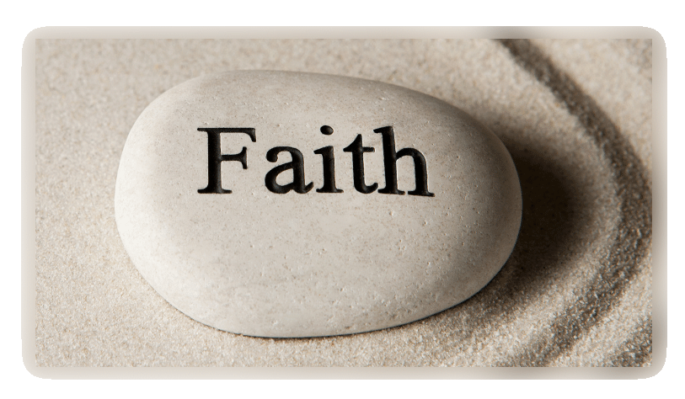
Trust & Obey the Lord – No Matter What!
THE JUST
Rom. 1:17; 1 Cor. 6:9-11
SHALL LIVE
Gal. 3:11; Heb. 10:1-10; 11:29-40
BY FAITH
Heb. 10:38; Jas. 2:14-20
Notes:
Trust (Believe, Have Faith) and Obey the Lord – No Matter What!
Don’t Accept the Contention, “All you have to do” is believe. Or any doctrine that denies the necessity of obedience
As indicated, Abraham’s faith was accounted to him for righteousness because it was an obedient faith!
This is indicated by the Phrase, the “just shall live by faith.”
[CLICK] The JUST shall live by Faith
(Romans 1:17), “For in it [the gospel] the righteousness of God is revealed from faith to faith; as it is written, “The just shall live by faith.”
THE JUST here clearly refers to those who are called by the power of the gospel of Christ.
The meaning of “from faith to faith” from THE Faith to OUR Faith.
We who embrace THE Faith are the elect, the called out, the Justified. We are contrasted to the world
As Paul said in 1 Corinthians 6
(1 Corinthians 6:9-11), “Do you not know that the unrighteous will not inherit the kingdom of God? Do not be deceived. Neither fornicators, nor idolaters, nor adulterers, nor homosexuals, nor sodomites, nor thieves, nor covetous, nor drunkards, nor revilers, nor extortioners will inherit the kingdom of God. And such were some of you. But you were washed, but you were sanctified, but you were justified in the name of the Lord Jesus and by the Spirit of our God.”
Ultimately, our choosing is what makes us different from the alien sinner. The election is an act that Jesus does for us (He chooses us through the gospel of the Lord.
[CLICK] The just SHALL LIVE by faith
(Galatians 3:11), “But that no one is justified by the law in the sight of God is evident, for “the just shall live by faith.”
Here we see the basis of our life! (Our standing with God, as opposed to separation from Him.
The reason for spiritual death is sin.
No avenue is available to escape from the consequences of sin, except through faith in Jesus Christ, who is uniquely our Savior!
(Hebrews 10:1-10), ”For the law, having a shadow of the good things to come, and not the very image of the things, can never with these same sacrifices, which they offer continually year by year, make those who approach perfect. For then would they not have ceased to be offered? For the worshipers, once purified, would have had no more consciousness of sins. But in those sacrifices there is a reminder of sins every year. For it is not possible that the blood of bulls and goats could take away sins. Therefore, when He came into the world, He said: ‘Sacrifice and offering You did not desire, But a body You have prepared for Me. In burnt offerings and sacrifices for sin You had no pleasure. Then I said, ‘Behold, I have come— In the volume of the book it is written of Me— To do Your will, O God.’ Previously saying, ‘Sacrifice and offering, burnt offerings, and offerings for sin You did not desire, nor had pleasure in them’ (which are offered according to the law), then He said, ‘Behold, I have come to do Your will, O God.’ He takes away the first that He may establish the second. By that will we have been sanctified through the offering of the body of Jesus Christ once for all.”
Eternal life was, is, and always shall be through faith in Jesus!
(Hebrews 11:39-40), “And all these [those who lived before Jesus], having obtained a good testimony through faith, did not receive the promise, God having provided something better for us, that they should not be made perfect apart from us.”
[CLICK] The just shall live BY FAITH!
(Hebrews 10:38), “Now the just shall live by faith; But if anyone draws back, My soul has no pleasure in him.”
Here is where the concept of steadfastness or faithfulness comes in.
Can you believe a person who says they have faith in Jesus, if it is not seen in their conduct and speech?
NO! What Jesus stands for and instructs are our marching orders as His disciples.
We don’t life as we want, but as He wants! (Selflessness and Humility, not Selfishness and Pride!)
Consider these words from James
(James 2:14-20), “What does it profit, my brethren, if someone says he has faith but does not have works? Can faith save him? If a brother or sister is naked and destitute of daily food, and one of you says to them, ‘Depart in peace, be warmed and filled,’ but you do not give them the things which are needed for the body, what does it profit? Thus also faith by itself, if it does not have works, is dead. But someone will say, ‘You have faith, and I have works.’ Show me your faith without your works, and I will show you my faith by my works. You believe that there is one God. You do well. Even the demons believe—and tremble! But do you want to know, O foolish man, that faith without works is dead?”

Slide 3
Conclusion (Galatians 2:20)
Notes:
Conclusion
So, there are certain things we can note from this text.
First, faith in Jesus is the only way to access God’s grace. The only way to obtain the gift of His Son which can reconcile us to God and save our souls
Second, God requires that faith in Him be seen in our daily lives and conduct. To be just we have to live in accord with the faith delivered from God to man. Consider the following words…
(Galatians 2:20), “I have been crucified with Christ; it is no longer I who live, but Christ lives in me; and the life which I now live in the flesh I live by faith in the Son of God, who loved me and gave Himself for me.”

