Slide 1
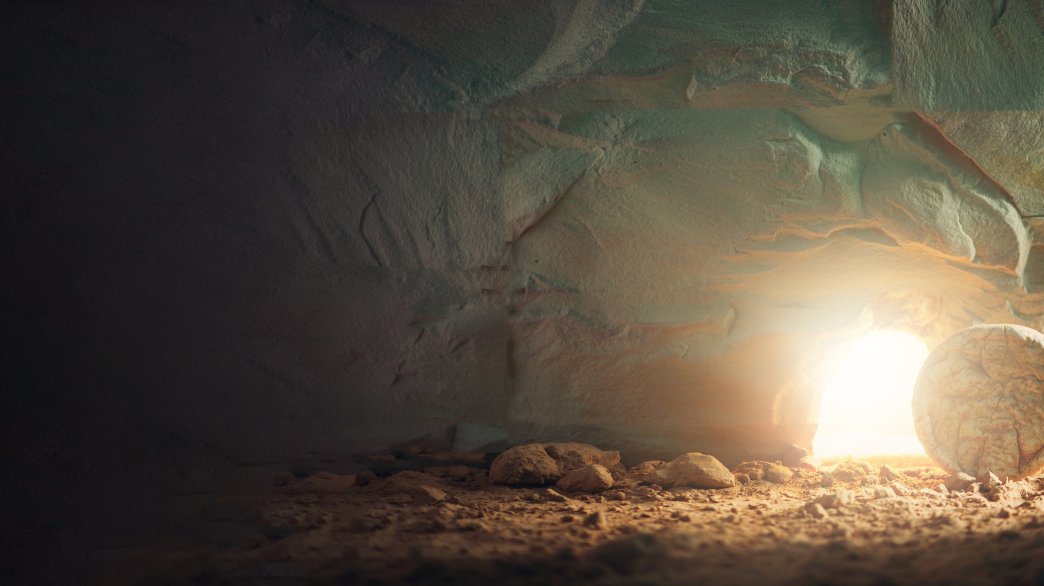
The
Significance of the
Resurrection of Jesus
1 Corinthians 15
Notes:
The Significance of the Resurrection of Jesus
1 Corinthians 15:1-11
Introduction:
In my study and teaching of non-believers, I have always tried to show evidence of Jesus' Resurrection from the dead.
One of the primary evidences I have always supplied is the eyewitness testimony of Saul of Tarsus
His testimony, and character, as hostile to the gospel of Christ, is unimpeachable.
After learning of the truth of Christ's resurrection, he went from chief persecutor to a leading proponent of Christianity
His declaration of having seen the resurrected Lord is contained in 1 Corinthians 15:8-11
1 Corinthians 15:8-11 Then last of all He was seen by me also, as by one born out of due time. (9) For I am the least of the apostles, who am not worthy to be called an apostle, because I persecuted the church of God. (10) But by the grace of God I am what I am, and His grace toward me was not in vain; but I labored more abundantly than they all, yet not I, but the grace of God which was with me. (11) Therefore, whether it was I or they, so we preach and so you believed.
I read an article recently that has some interesting facts about how Americans feel about the resurrection of Jesus. In effect, we have different problem that the one Paul addressed in 1 Corinthians 15.
It states that actually 2/3 of all Americans believe that Jesus was raised from the dead!
Could it be that in many cases, the problem is not a lack of faith in Jesus' resurrection, and more a failure to understand it's significance to your own spiritual life?
While 67% of Americans believe in Jesus' resurrection, only 36% believe that they will be resurrected from the dead!

Slide 2
"Despite accepting the biblical accounts of Jesus’ resurrection, many Americans have conflicting thoughts about the Bible and seem to see little connection between Jesus rising again and their daily lives.
“In 2022, for the first time in the history of the State of Theology study, a majority of Americans (53%) say the Bible, like all sacred writings, contains helpful accounts of ancient myths but is not literally true. And 40%, the highest percentage yet, say modern science disproves the Bible.
“A growing percentage, up to a high of 32%, says God is unconcerned with their day-to-day decisions. And 3 in 5 (60%) say religious belief is a matter of personal opinion, not objective truth."
Notes:
[CLICK - for quote slide]
Consider the following quote from the article reporting these numbers:
"Despite accepting the biblical accounts of Jesus’ resurrection, many Americans have conflicting thoughts about the Bible and seem to see little connection between Jesus rising again and their daily lives.
In 2022, for the first time in the history of the State of Theology study, a majority of Americans (53%) say the Bible, like all sacred writings, contains helpful accounts of ancient myths but is not literally true. And 40%, the highest percentage yet, say modern science disproves the Bible.
A growing percentage, up to a high of 32%, says God is unconcerned with their day-to-day decisions. And 3 in 5 (60%) say religious belief is a matter of personal opinion, not objective truth."
In effect, for many is not: Was Jesus resurrected? Rather, it is: Jesus was resurrected, So what?
The fact of the resurrection, however, ultimately impacts every aspect of our current and future existence
If you believe in Jesus' resurrection, the are certain logical conclusions, that if pursued, naturally and inevitably follow
Let's consider a few of them
Americans Believe in Easter Resurrection But Aren’t Sure Why It Matters (Apr 5, 2023) By Aaron Earls
https://research.lifeway.com/2023/04/05/americans-believe-in-easter-resurrection-but-arent-sure-why-it-matters/

Slide 3
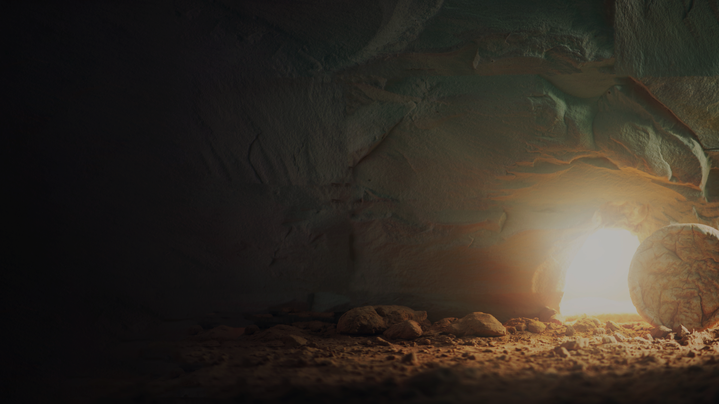
The Resurrection of Jesus
Paul’s Argument to the Corinthians
(15:12-14; 20-23)
Jesus Christ is Savior
  (15:17-19) Isaiah 53:11-12
Jesus Christ is Lord
  (15:24-28) Matthew 28:16-20
Reward and Punishment are Real
  (15:57-58) 2 Thessalonians 1:6-10
Notes:
[CLICK]
Discussion:
First let us consider why Paul wrote to the Corinthians!
1 Corinthians 15:12-14 Now if Christ is preached that He has been raised from the dead, how do some among you say that there is no resurrection of the dead? (13) But if there is no resurrection of the dead, then Christ is not risen. (14) And if Christ is not risen, then our preaching is empty and your faith is also empty.
Our own resurrection is inextricably tied to the resurrection of Jesus
1 Corinthians 15:20-23 But now Christ is risen from the dead, and has become the firstfruits of those who have fallen asleep. (21) For since by man came death, by Man also came the resurrection of the dead. (22) For as in Adam all die, even so in Christ all shall be made alive. (23) But each one in his own order: Christ the firstfruits, afterward those who are Christ's at His coming.
The opposite of "if Christ is not risen, the our preaching is empty and your faith is also empty" is the following; Since Christ is risen, our preaching is with divine power, and your faith leads to eternal life! (Not irrelevant at all!)
[CLICK] Christ's Resurrection shows that we have a Savior!
1 Corinthians 15:17-19 And if Christ is not risen, your faith is futile; you are still in your sins! (18) Then also those who have fallen asleep in Christ have perished. (19) If in this life only we have hope in Christ, we are of all men the most pitiable.
Isaiah 53:11-12 He shall see the labor of His soul, and be satisfied. By His knowledge My righteous Servant shall justify many, For He shall bear their iniquities. (12) Therefore I will divide Him a portion with the great, And He shall divide the spoil with the strong, Because He pou{red out His soul unto death, And He was numbered with the transgressors, And He bore the sin of many, And made intercession for the transgressors.
[CLICK] Christ's Resurrection shows that He is our Lord!
1 Corinthians 15:24-28 Then comes the end, when He delivers the kingdom to God the Father, when He puts an end to all rule and all authority and power. (25) For He must reign till He has put all enemies under His feet. (26) The last enemy that will be destroyed is death. (27) For "HE HAS PUT ALL THINGS UNDER HIS FEET." But when He says "all things are put under Him," it is evident that He who put all things under Him is excepted. (28) Now when all things are made subject to Him, then the Son Himself will also be subject to Him who put all things under Him, that God may be all in all.
Matthew 28:16-20 Then the eleven disciples went away into Galilee, to the mountain which Jesus had appointed for them. (17) When they saw Him, they worshiped Him; but some doubted. (18) And Jesus came and spoke to them, saying, "All authority has been given to Me in heaven and on earth. (19) Go therefore and make disciples of all the nations, baptizing them in the name of the Father and of the Son and of the Holy Spirit, (20) teaching them to observe all things that I have commanded you; and lo, I am with you always, even to the end of the age." Amen.
[CLICK] Reward and Punishment are Real!
Christ's message to the Corinthians, as they were Christians is that discipleship leads to reward!
1 Corinthians 15:57-58 But thanks be to God, who gives us the victory through our Lord Jesus Christ. (58) Therefore, my beloved brethren, be steadfast, immovable, always abounding in the work of the Lord, knowing that your labor is not in vain in the Lord.
However, the resurrection in the judgment day leads to punishment for the wicked as well!
2 Thessalonians 1:6-10 since it is a righteous thing with God to repay with tribulation those who trouble you, (7) and to give you who are troubled rest with us when the Lord Jesus is revealed from heaven with His mighty angels, (8) in flaming fire taking vengeance on those who do not know God, and on those who do not obey the gospel of our Lord Jesus Christ. (9) These shall be punished with everlasting destruction from the presence of the Lord and from the glory of His power, (10) when He comes, in that Day, to be glorified in His saints and to be admired among all those who believe, because our testimony among you was believed.

Slide 4
Conclusion
Our resurrection is dependent upon Jesus’ resurrection. (15:20-23)
Our life has significance as a result of His victory over death!
Notes:
[CLICK] Conclusion:
Our own resurrection is dependent upon the resurrection of Jesus' Christ.
1 Corinthians 15:20-23 But now Christ is risen from the dead, and has become the firstfruits of those who have fallen asleep. (21) For since by man came death, by Man also came the resurrection of the dead. (22) For as in Adam all die, even so in Christ all shall be made alive. (23) But each one in his own order: Christ the firstfruits, afterward those who are Christ's at His coming.
Our life has significance as a direct result of His death on the cross
1 Corinthians 15:57-58 But thanks be to God, who gives us the victory through our Lord Jesus Christ. (58) Therefore, my beloved brethren, be steadfast, immovable, always abounding in the work of the Lord, knowing that your labor is not in vain in the Lord.

